Slide 1
Python Fundamentals - Day 3
NumPy - Part 1

Slide 2
NumPy: Introduction
NumPy, which stands for "Numerical Python," is a powerful Python library for numerical computations and data manipulation.
It provides a multidimensional array object, along with a collection of functions and tools for working with these arrays.
NumPy is widely used in scientific computing, data analysis, and machine learning applications.

Slide 3
NumPy: Key Features
ndarray: The core data structure in NumPy is the ndarray (n-dimensional array). It represents a homogeneous, fixed-size collection of elements of the same data type. ndarrays provide efficient storage and operations for numerical computations.
Fast Mathematical Operations: NumPy provides fast vectorized operations, allowing you to perform computations on entire arrays rather than individual elements. This results in faster execution times compared to traditional Python loops.

Slide 4
NumPy: Key Features cont.
Broadcasting: NumPy enables broadcasting, which allows for arithmetic operations between arrays of different shapes and sizes. Broadcasting automatically aligns the dimensions of the arrays to perform element-wise operations.
Array Manipulation: NumPy offers various functions for reshaping, slicing, and joining arrays. These functions provide flexibility in manipulating the shape and structure of arrays.

Slide 5
NumPy: Key Features cont.
Array Aggregation: NumPy provides aggregation functions, such as sum, mean, min, max, etc., for computing statistics on arrays. These functions operate on the entire array or along specific axes, allowing for efficient data summarization.

Slide 6
NumPy: Creating an Array
NumPy arrays can be created using various methods, such as np.array(), np.zeros(), np.ones(), np.arange(), etc. These functions allow you to specify the shape, size, and initial values of the arrays.

Slide 7
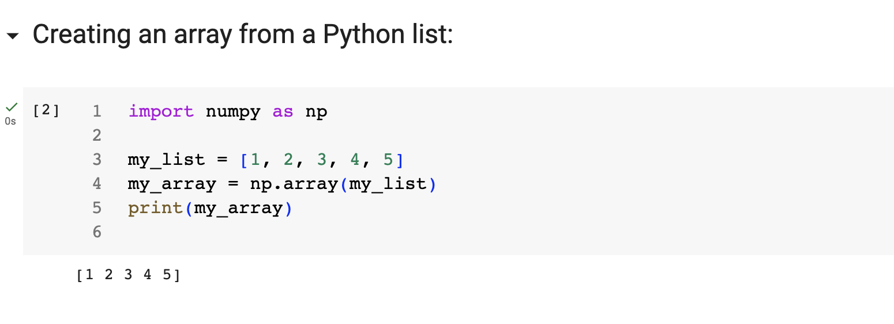

Slide 8
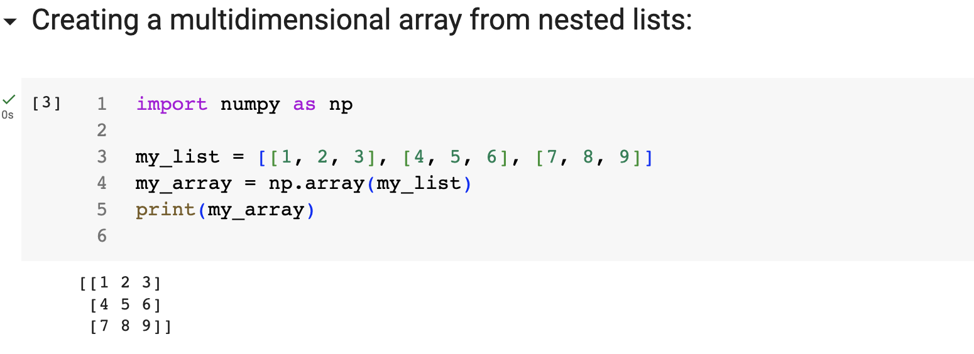

Slide 9
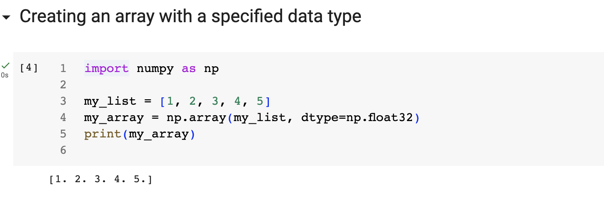

Slide 10
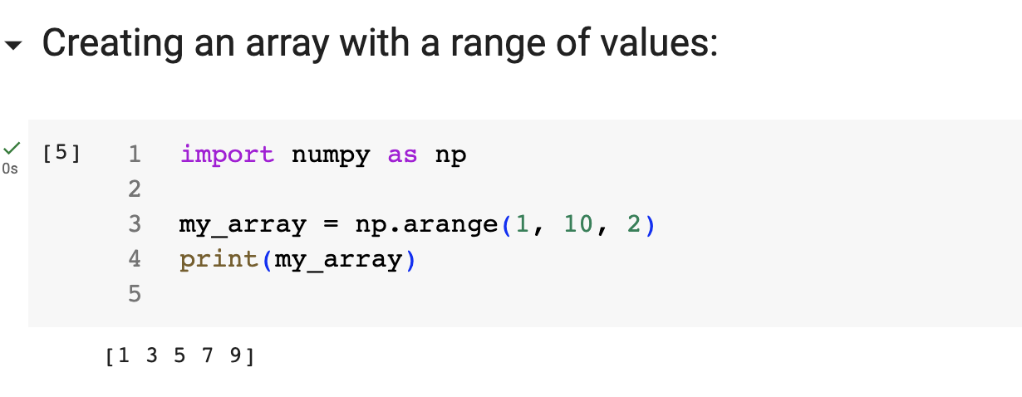

Slide 11
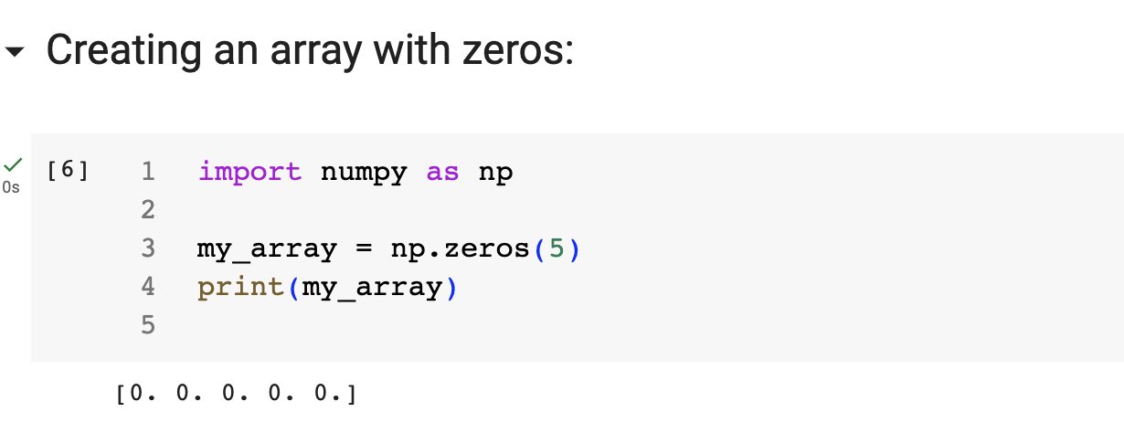

Slide 12
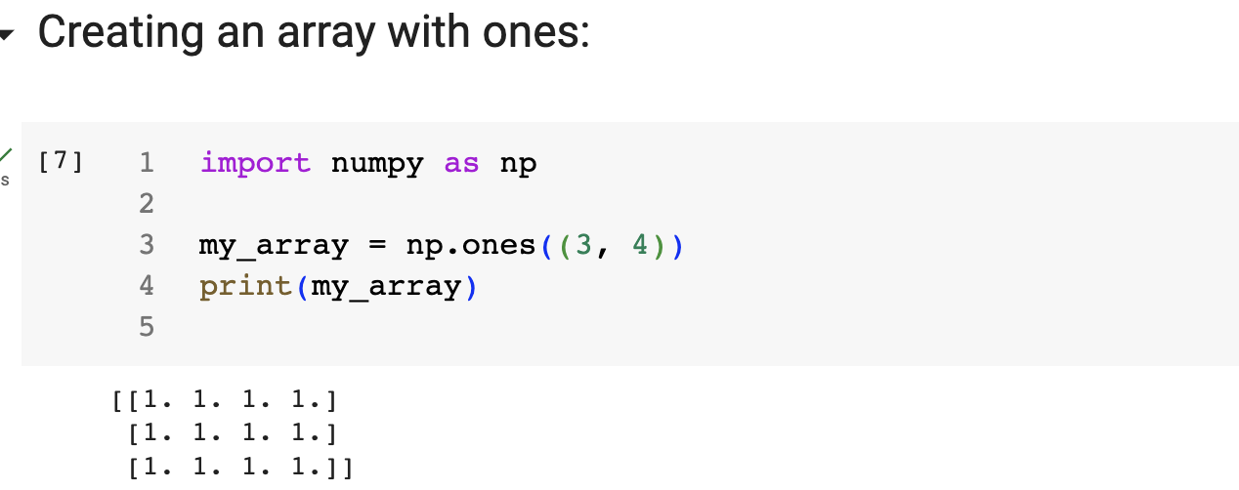

Slide 13
NumPy Code Demo 1: Matrix Multiplication
Link: https://docs.google.com/document/d/13nDrNTcvuJNFJ3NMPsUx9MKJFdR2E9lxcSnbA2KWYkI/edit?usp=share_link

Slide 14
NumPy Code Demo 2: Array Operations
Link: https://docs.google.com/document/d/1xqcmHBwSCSFA3NyeBnvGS516XbGbNY54I4EGlbMbLUo/edit?usp=share_link

Slide 15
NumPy: Array Arithmetic
Element-wise operations: NumPy allows you to perform arithmetic operations on arrays element-wise. This means that the corresponding elements of the arrays are operated on individually.

Slide 16
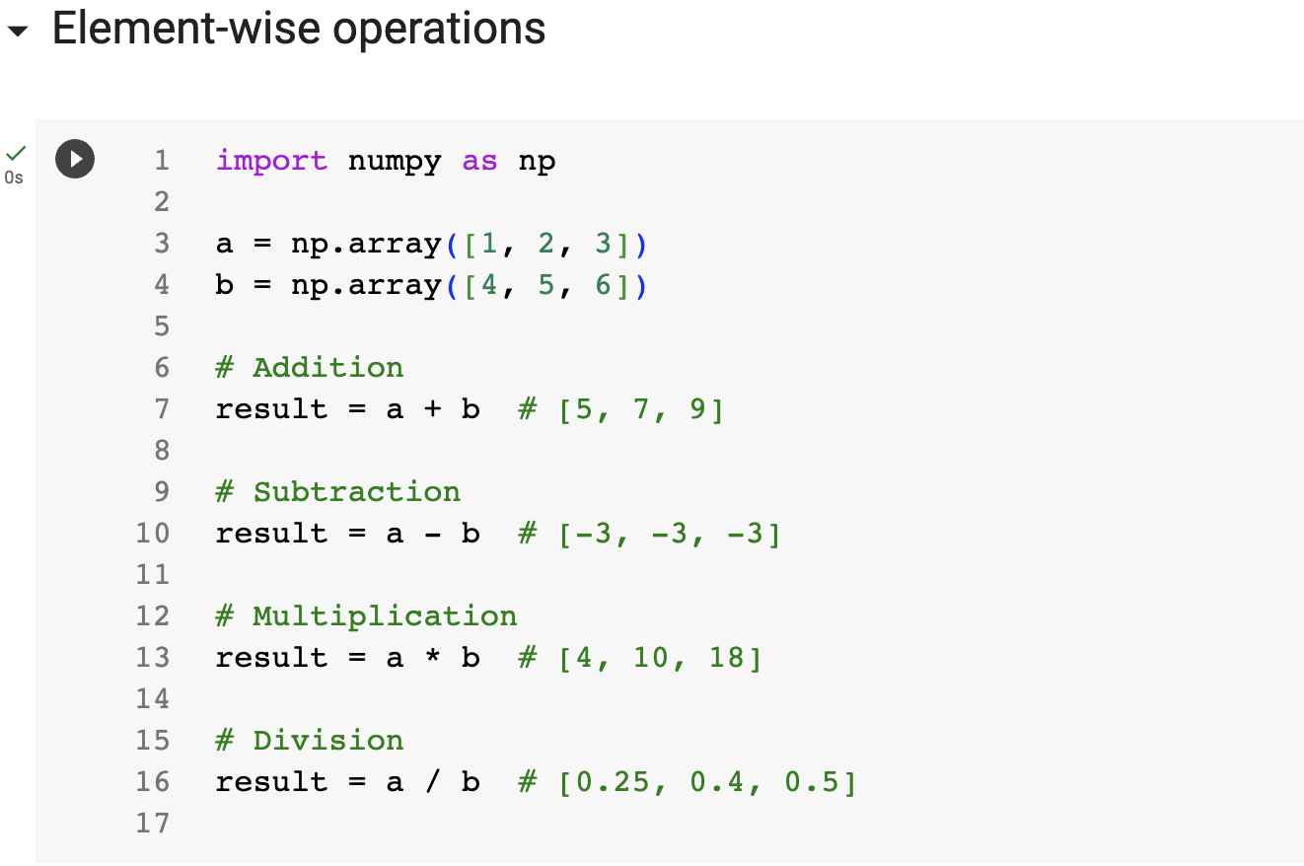

Slide 17
NumPy: Array Arithmetic cont.
Scalar operations: You can perform arithmetic operations between an array and a scalar value. The scalar value is applied to each element of the array.

Slide 18
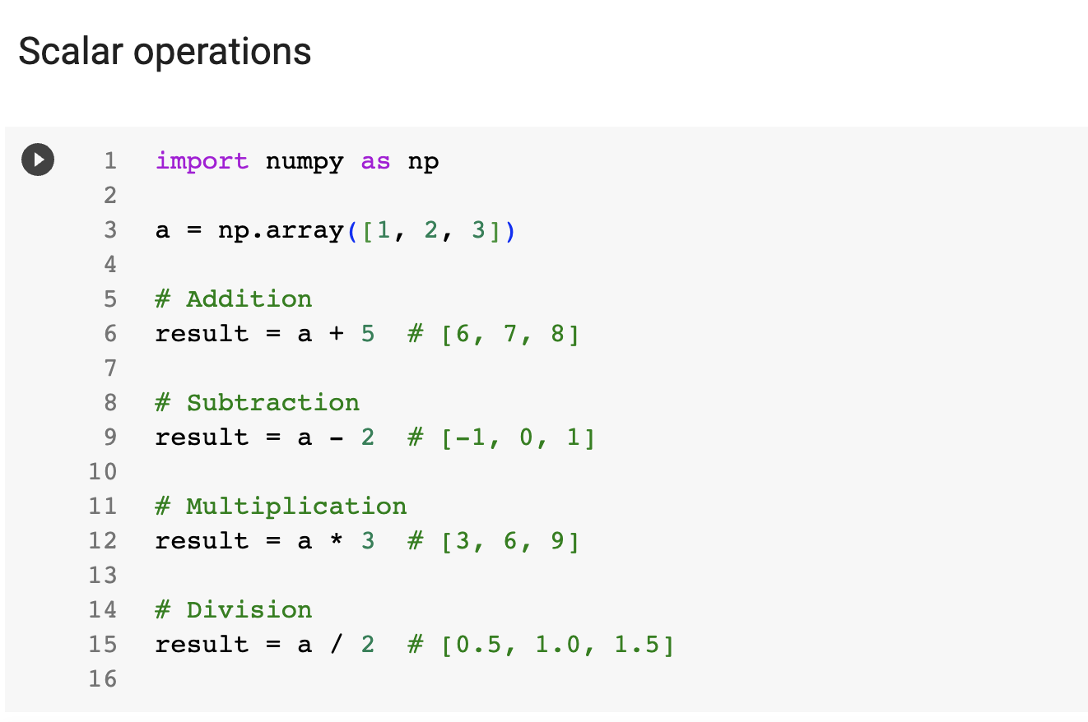

Slide 19
NumPy: Array Arithmetic cont.
Matrix operations: NumPy also provides functions for matrix operations, such as matrix multiplication (np.dot() or @ operator), element-wise matrix multiplication (np.multiply() or * operator), and matrix exponentiation (np.linalg.matrix_power()).

Slide 20
NumPy Code Demo 3: Array Arithmetic
Link:
https://docs.google.com/document/d/12wlSkf0xwQC3JR9ot0Y6mqUglTKIMAPJrQo_fw0lstE/edit?usp=share_link

